Slide 1
Making the Most of Your Museum Membership
Notes:
Introduction
Here to talk to you today about how to make the most of your museum membership

Slide 2
Three Options for Museum Membership
Notes:
The first is our Tier 1 membership which is a pay what you can level
Get you access to ethics, standards, and advocacy resources
Discounted registration for Museums Advocacy Day
Eligibility to present at the Annual Meeting
Listing in our online museum directory
Subscription to our e-newsletters

Slide 3
Three Options for Museum Membership
Access to the Transamerica Museum Retirement Program
Notes:
Second option is our Tier 2 membership and the dues for this level are based on full-time staff size – general rule of thumb is full time staff (paid or unpaid) with full-time museum responsibilities
All of the benefits of Tier 1 as well as
Access to our online resource library
Subscription to Museum magazine
Discounts on online learning, books, individual professional memberships, and more

Slide 4
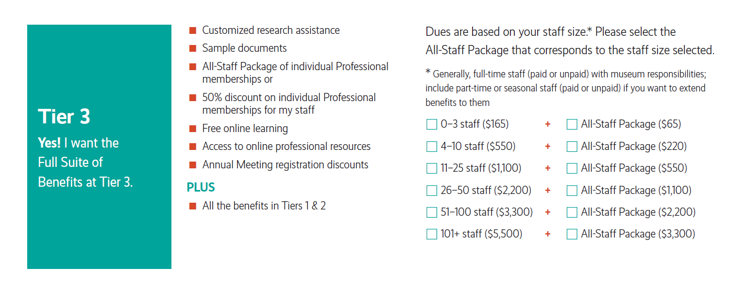
Three Options for Museum Membership
Notes:
The final option is our Tier 3 membership – which like the Tier 2 is based on full-time staff size
This level includes all of the benefits of Tiers 1 and 2, but has some added benefits such as
Sample documents library
Customized research assistance
Free online learning
Optional add-on: all-staff package

Slide 5
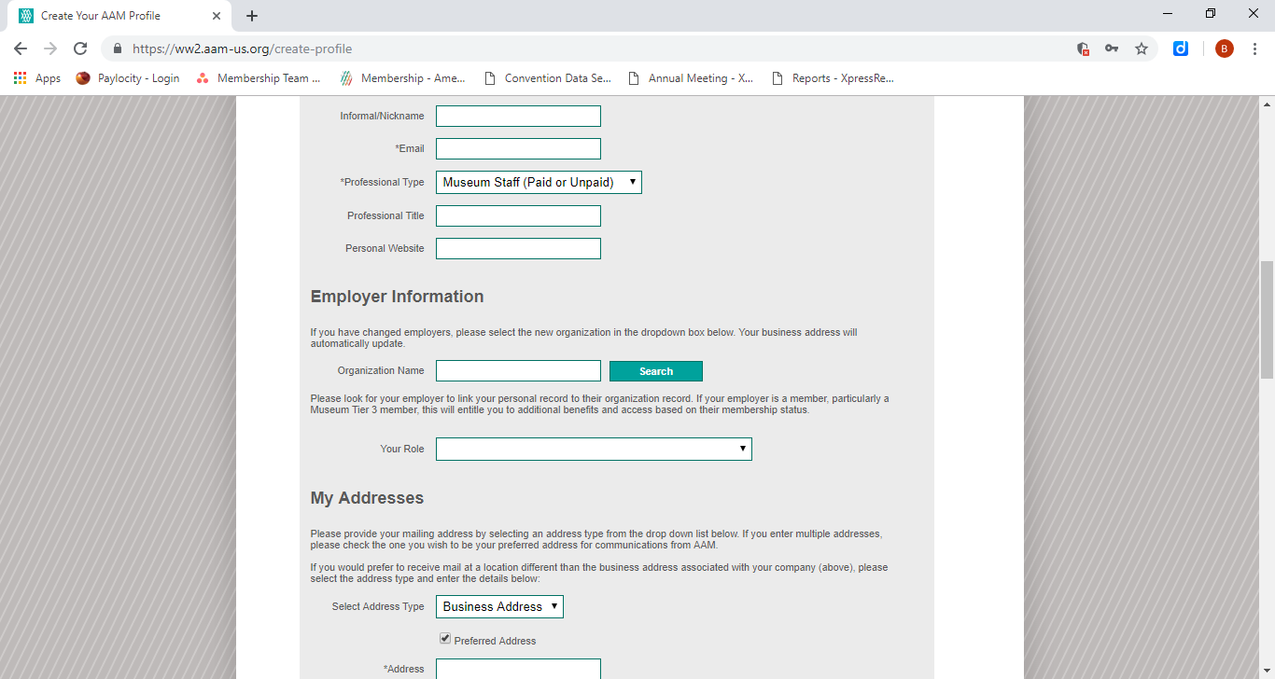
How do you access these benefits and resources?
Create an individual login on our website and list the museum as your employer
This will link you to the museum’s account in our system and provide access to these benefits and resources
Notes:
To access your member benefits and resources, use your individual login that you already have OR if you (or a colleague) don’t have a profile in our system, create a profile on our website and list the museum as your employer – this will link you to the museum in our system and give you access to their member benefits and resources
Our system does not have institutional logins – each staff member can have their own username and password to access the museum’s member resources!

Slide 6
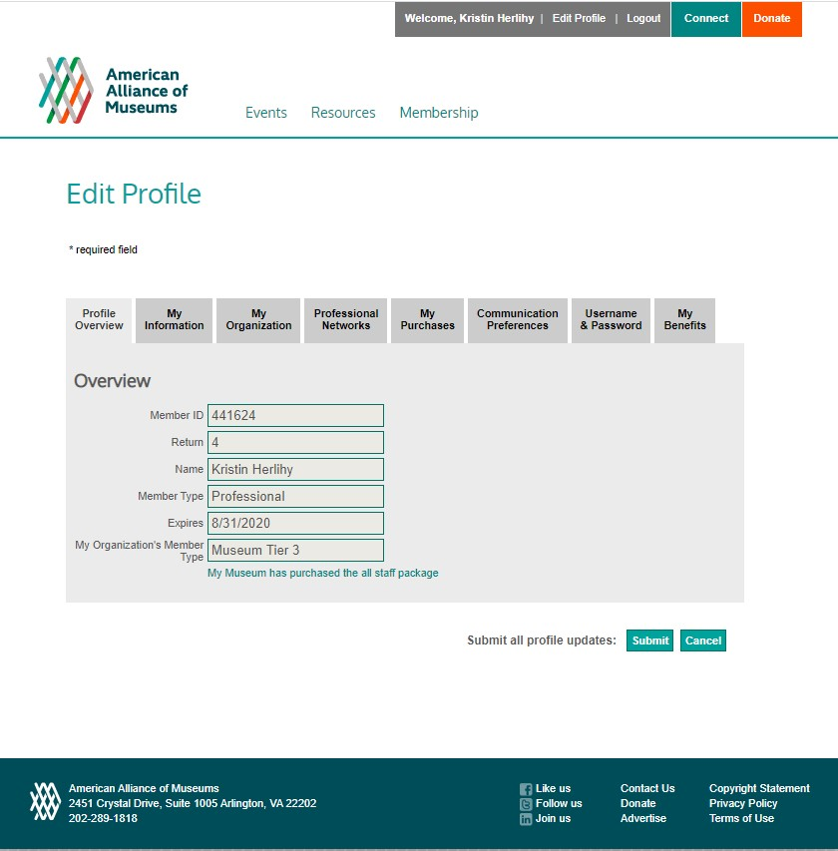
How do you find out if your museum is a member or if the membership is current?
Notes:
Most of you will likely already have logins through the AAM website, so to check the status of your museum’s membership, you can log into the website and go to the edit profile page to see your profile overview
You can also use our online museum directory and search for your museum

Slide 7
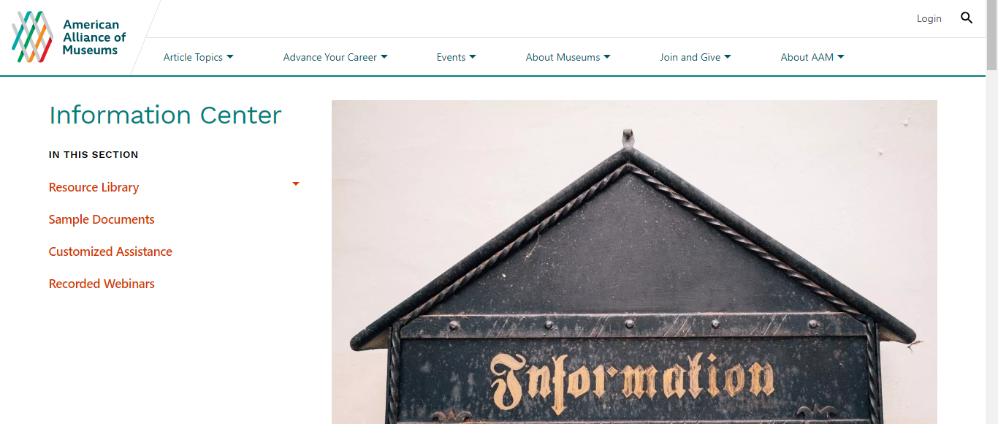
Where do you find your member resources?
Notes:
Section on our website called the Information Center – this is where you can find the Resource Library, the Sample Documents Library, the Customized Research Assistance Poral, and a listing of our recorded webinars available for purchase/download

Slide 8
Get your colleagues involved!
Have all everyone create accounts with us to receive our weekly emails
Tell your colleagues if you’ve renewed or upgraded your membership so they can take full advantage of your benefits
Leave issues of Museum out in shared spaces

Slide 9
Questions?
Email us: membership@aam-us.org

