Slide 1
No Need to Re-Invent the Wheel – Sample Documents and You!
How to use this AAM Membership benefit
Notes:
Hi Everyone,
My name is lauren, I’m member services manager at AAM, and I’m excited to talk about AAM’s Sample Document Library! This is a treasure-trove of examples of policies and procedures from other museums that will save you time and money!

Slide 2
What is a Sample Document? What is the Sample Document library?
A Sample Document is an internal document from an accredited museum
The Sample Document Library is a database of 1,000 sample policies, plans and forms from museums of all types and sizes.
Access to the library is a benefit of Tier 3 membership
Notes:
A sample document is an internal document from an accredited museum. Accreditation means that the museum has earned a mark of distinction and excellence in our field, and all documents have been vetted by the accreditation commission. Documents can range from the required Core documents, such as Mission Statement, Institutional Code of Ethics, Strategic Institutional Plan
Disaster Preparedness/Emergency Response Plan, Collections Management Policy. More specialized documents are also included, such as volunteer handbooks, sexual harassment polices, and live collections care policies. There are more than 1,000 and they are updated regularly.

Slide 3
Why are Sample Documents valuable?
Informative- see policies from museums similar and different from your institution
Saves time- rather than re-invent the wheel, use another organization’s example to get started on your own
Accreditation help- see examples of documents from accredited museums
Benchmarking- see how your museum’s policies compare
Notes:
Why are these so valuable?
These are an informative benchmarking tool. You can see how your museum’s policies compare to other museums of similar subject, size, governance, ect.
You can also save so much time. You can download these policies and use and update for your own purposes, rather than having to completely write a policy from scratch.
These sample are also incredibly useful when participating in any of our excellence programs, such as submitting your Core Documents, or applying for Accreditation. These documents are all from Accredited museums, so you’ll know that anything from this library is an excellent example of an accreditation-ready museum. You can use them as a guide for the creation of your own accreditation-quality documents.

Slide 4
How do I access a Sample Document?
Create a log-in
Verify your museum is a Tier 3 Museum member of AAM
Access the Sample Document Library
Notes:
Creating a log-in is very easy to do on our website. Simply go to www.aam-us.org, and click the log-in button. There will be a “new users create a profile” option which you should select. Most important with setting up your profile is indicating your employer. This links you to their member benefits
After you create a profile, check out your overview. It will show if you have a membership, and if your org is a member.
Once you’ve created a log-in, you can access the sample documents via the resource library.

Slide 5
In the Sample Document Library
Notes:
When you log in, you see all of the documents we have in the library. There are a number of different ways to find what you’re looking for. The left-hand side shows all of the different folders in the library, sorted by what type of document you are looking for. The top right corner gives you options for how you want to view your results (thumbnails as seen here or a list). The furthest button to the right, the one that looks like a funnel, is your filter button which lets you narrow down the way you view results

Slide 6
Filters
Notes:
You can filter results by document type, date it was submitted, museum that submitted it, type of museum that submitted, budget size, and governance type. Lets say I work for a small historic house museum, and I want to find some ethics policies. First, I navigate to the folder with ethics documents. I then click“filter.” I know that I want a recent document, so I change my filter so only pull results from documents submitted in the last five years. I also want to sort by museums that have a similar budget and governance as my own museum. Bingo! I have a couple results that match my needs exatly.

Slide 7
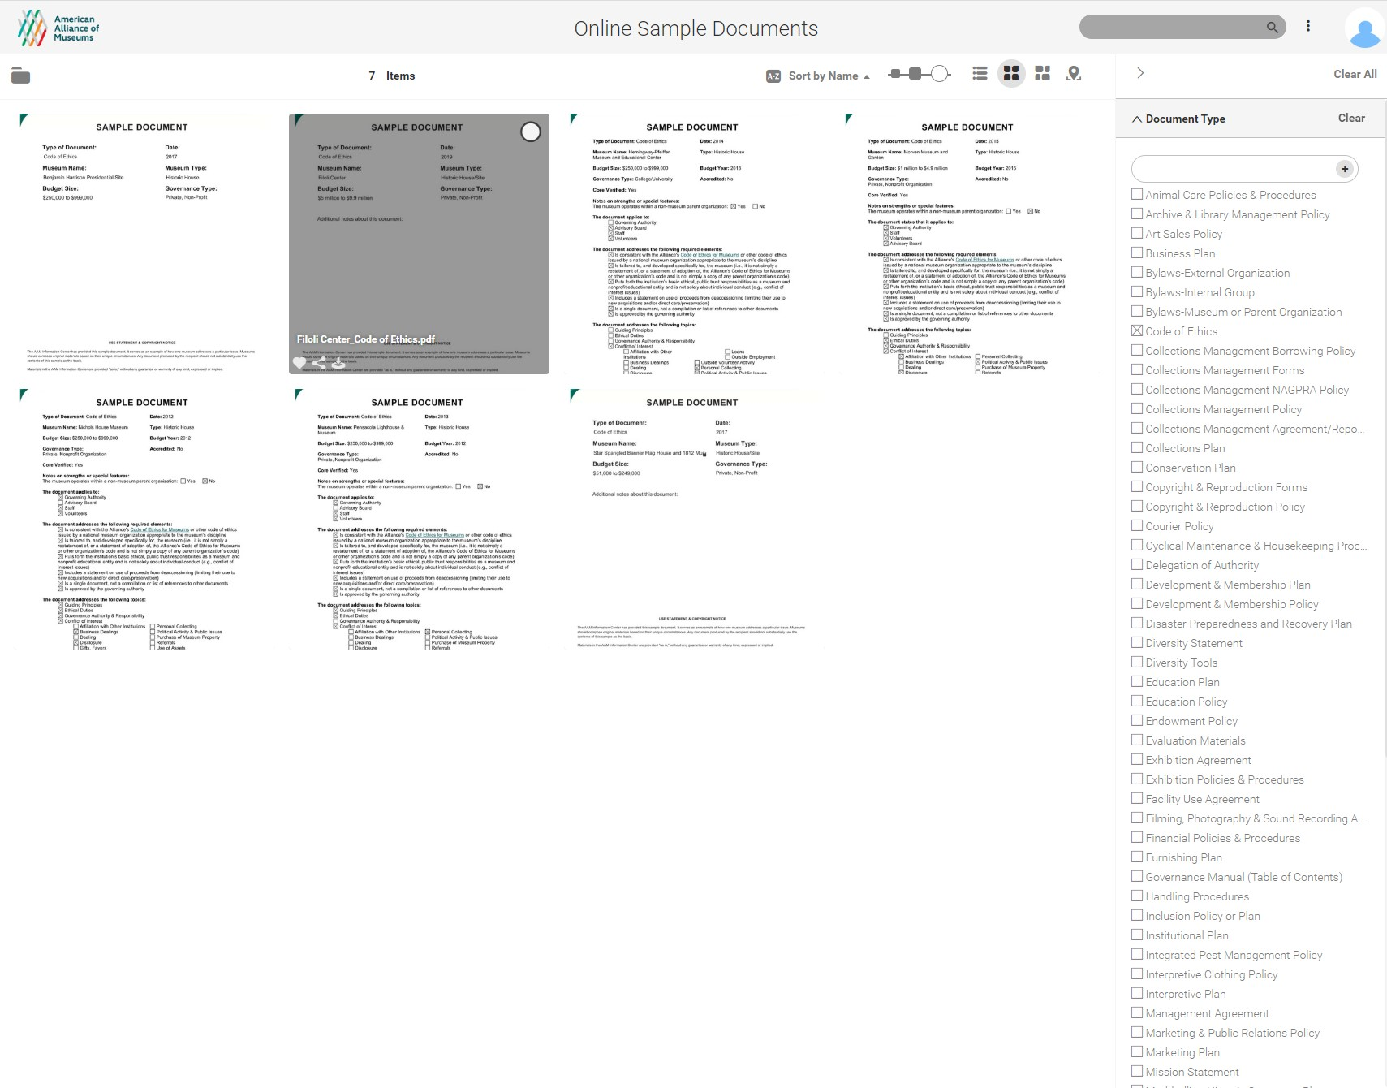
Browse view: document type
Notes:
I can also browse and see a number of documents by a certain type. Lets say I am re-evaluating my statement of Ethics. I can browse the Sample Documents Library for all Ethics documents, and read them all to get a sense of what is generally included in Code of Ethics.

Slide 8
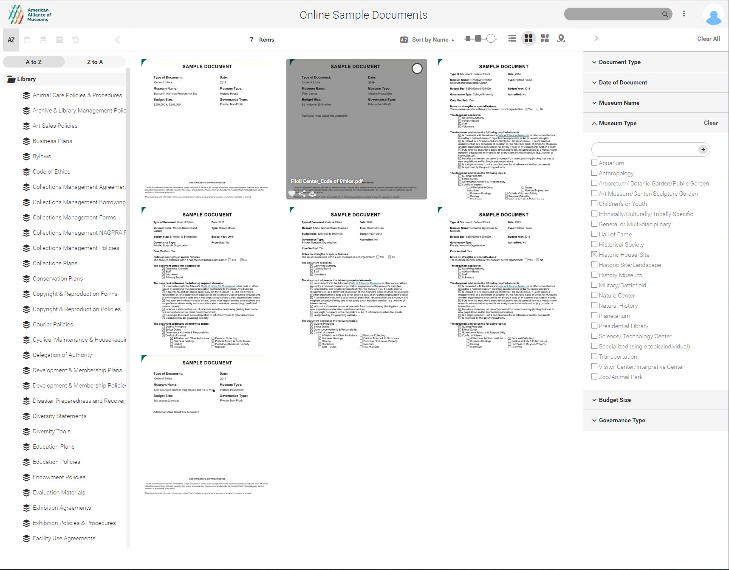
Browse view: museum type
Notes:
I can also browse within a few parameters. let's say I need a new code of Ethics for my museum. I can filter Code of ethics AND historic house to find sample ethics codes from historic house museums.

Slide 9
Browse view: individual document
Notes:
You can click on each document in your search result to see a brief summary of the document. You can move to the next or the previous document using these arrows. If you want to read the whole document, click open (animation)

Slide 10
Search View
Notes:
There is also a search function, if you know exactly what you’re looking for you can use this tool to track it down quickly. This is really useful if you want to search for documents from a specific museum.

Slide 11
Questions?
Questions about membership? Email us membership@aam-us.org
Questions about accreditation? Reach out to our Excellence Officers at accreditation@aam-us.org
Questions about accreditation-readiness programs such as the Museum Assessment Program (MAP)? Reach out to our MAP Team at map@aam-us.org
Notes:
If you have any questions about accessing the sample documents, please don’t hesitate to get in touch with us. You can see our contact emails available on the screen.

Slide 12
Notes:
Thank you all for taking the time to listen, from all of us here at AAM.

